Slide 1

SIOP Model:
Sheltered Instruction Observation Protocol
Adriene Umecker
Michelle Stukel

Slide 2
What is the SIOP Model?
The SIOP Model is a research-based and validated model of sheltered instruction.
An observation protocol (rating instrument)
A lesson planning and delivery system

Slide 3
Who uses the SIOP Model?
Elementary classroom teachers
Secondary subject-area teachers
ESL teachers
Two-Way Immersion teachers
Bilingual teachers
Instructional coaches
Staff developers
School and district administrators
Teacher education faculty
Pre-service teacher candidates

Slide 4
How the SIOP Model is used?
Research observation tool for fidelity of model implementation
Supervision and observation tool of student teachers
Classroom observation tool by administrators
Teacher self-reflection tool
Lesson plan checklist

Slide 5
Who benefits from SIOP instruction?
When the SIOP Model is fully enforced, English Learners’ academic performance improves.
SIOP-based teaching benefits all students, not just those who are learning English as an additional language when implemented correctly.
SIOP instruction also benefits students learning content through another language.

Slide 6
8 Interrelated Components
Lesson Preparation
Building Background
Comprehensible Input
Strategies
Interaction
Practice/Application
Lesson Delivery
Review/Assessment

Slide 7
1. Building Background
Includes the following elements:
  Concepts explicitly linked to students' background experiences
  Links explicitly made between past learning and new concepts
  Key vocabulary emphasized
    (ex: introduced, written, repeated, and highlighted for students to see)

Slide 8
2. Lesson Preparation
Includes the following components:
  Clearly defined content objectives for students
  Clearly defined language objectives for students
  Content concepts appropriate for age and educational background
  Supplementary materials used to a high degree, making the lesson clear and meaningful (ex: graphs, models, visuals)
  Adaptation of content (ex: text, assignment) to all levels of student proficiency
  Meaningful activities that integrate lesson concepts (e.g., surveys, letter writing, simulations, constructing models) with language practice opportunities for reading, writing, listening, and/or speaking

Slide 9
Examples of Preparation
Sub-sections of Preparation
  Content Objectives
  Language Objectives
  Content Concepts
  Supplementary Materials

Slide 10
Group Activity!
Create a mini-lesson (Jump-start Lesson)
Please Include:
  Brief explanation on subject and background information needed.
  1-2 specific and simple objectives
  Use of supplementary materials (pg. 27-28)
  Why is the lesson effective?

Slide 11
Examples of Preparation
Sub-sections of Preparation
  Adaptation of Content
  Meaningful Activities

Slide 12
3. Comprehensible Input
Includes the following components:
  Speech appropriate for students‘ proficiency level ( slower rate, careful enunciation)
  Clear explanation of academic tasks
  A variety of techniques used to make content concepts clear (demonstrations, gestures, etc.)

Slide 13
4. Strategies
Includes the following components:
  Ample opportunities for students to use strategies
  Consistent use of scaffolding techniques throughout lesson, assisting and supporting student understanding
  A variety of question types used, including those that promote higher-order thinking skills throughout the lesson.

Slide 14
5. Interaction
Includes the following components:
  Frequent opportunities for interactions and/or discussion between teacher/student and among students that encourage elaborated responses about lesson concepts
  Grouping configurations support language and content objectives of the lesson
  Sufficient wait time for student response
  Ample opportunities for students to clarify key concepts in L1 as needed with aide, peer, or L1 text

Slide 15
6. Practice/Application
Includes the following components:
  Hands-on materials for students to practice using new content knowledge
  Activities for student to apply content and language knowledge in the classroom
  Activities that integrate all language skills (reading, writing, listening, and speaking)

Slide 16
7. Lesson Delivery
Includes the following components:
  Content objectives clearly supported by lesson delivery
  Language objectives clearly supported by lesson delivery
  Students engaged approximately 90-100% of the period
  Pacing of the lesson appropriate to the students’ ability level

Slide 17
8. Review/Assessment
Includes the following components:
  Comprehensive review of key vocabulary
  Comprehensive review of key content concepts
  Regular feedback to students on their output
  Assessment of student comprehension and learning of all lesson objectives (ex: spot checking, group response) throughout the lesson

Slide 18
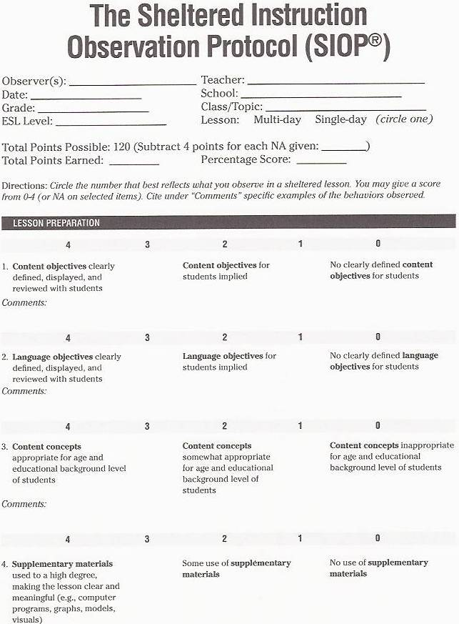

Slide 19
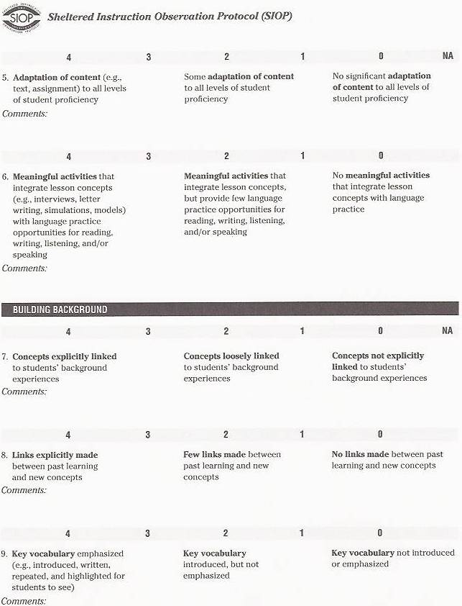

Slide 20
Outside Useful Links
http://www.prel.org/products/paced/fall06/siop.pdf
  SIOP Lesson Plan Outline with Guidelines
http://www.cal.org/siop/
  SIOP Home Page

